Slide 1
FAKE NEWS DETECTION

Slide 2
Abstract :- Mass media sources, specifically the news media, have traditionally informed us of daily events. In recent years, the reliability of information on the Internet has emerged as a crucial issue of modern society.

Slide 3
Problem: The proliferation of fake news on social media and Internet is deceiving people to an extent which needs to be stopped.

Slide 4
Our Solution :- Our goal is to develop a reliable model that classifies a given news article as either fake or true.

Slide 5
Introduction :- Fake news has been around for decades and is not a new concept. However, the dawn of the social media age has aggravated the generation and circulation of fake news many folds. Fake news can be simply explained as a piece of article which is usually written for economic, personal or political gains. Many scientists believe that fake news issue may be addressed by means of machine learning and artificial intelligence . Detection of such unrealistic news articles is possible by using various NLP techniques, Machine learning, and Artificial intelligence.

Slide 6
Feature Engineering
To differentiate a real article from a fake one, the empirical, syntactic and semantic characteristics of a given article are used to compute the features for the classification task. The various types of features that were experimented are as follows:
Empirical Features :-
Empirical features are based on the statistical anal-ysis of both the real and fake articles. They include the count of uncommon pairs of words within an ar-ticle, the ratio of perplexity of trigram and quadgram models for a given article and the nature of the POS tags that occur at the start and end of sentences in an article.

Slide 7
Ratio of Perplexity of trigram and quad-gram models
Given an article, the ratio of its perplexity for a tri-gram model to a quad-gram model is computed. The trigram and quad-gram models are both trained on the same BNC corpus. Both real and fake articles would give a low perplexity score for the tri-gram model but for the quad-gram model, real articles would have significantly lower perplexity than the fake articles.
This implies that the ratio of trigram to quad-gram perplexities would be lower for a fake article than for a real article. In other words, this ra-tio is similar to computing the likelihood ratio of an article w.r.t the trigram and quad-gram models. The histogram in Figure 1 shows a good separation in the distribution of values of this feature for the real and fake articles which indicates the effectiveness of this feature.

Slide 8
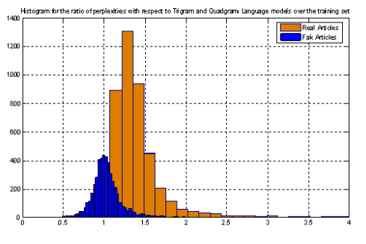
A quadgram language model is a better approximation of real text than a trigram model and by using this as a feature, we are able to demonstrate the usefulness of the classification task as a method for identifying good features for language modeling. In the subsequent sections, we investigate other fea-tures using this classification framework.

Slide 9
Count of uncommon pairs of words
Content words are the frequently occurring words in the corpus excluding the stop words. All the words in corpus are ranked according to frequency of their occurrence and content words are defined to be the words with rank between 150 and 6500. A list of common content word pairs (pairs of content words at least 5 words apart) is prepared from the real cor-pus by sorting the list of content word pairs by their frequency of occurrence and retaining those above a certain threshold. For a given article, a list of content word pairs is compared against this list and word pairs not in this list form the set of uncommon word pairs.

Slide 10
Start and End POS Tags Certain POS tags are more probable than others to appear at the beginning or end of a real sentence. This characteristic of real text could be used as a feature to distinguish real articles from fake. The distribution of POS tags of the first and last words of the sentences in an article is used as a feature. Our experiments show that this feature had very little ef- fect in the overall contribution to the classification accuracy over the development set.

Slide 11
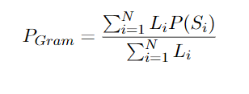
Syntactic Features
These features are derived from the parse struc-ture of the sentence. It is hypothesized that real sentences tend to be grammatical while the same may not be the case for fake sentences. An objec-tive measure of the grammaticality of a sentence can be obtained by running it through a statisti-cal parser. The log-likelihood score returned by the parser can be used to judge the grammatical-ity of a sentence and thus determine whether it is fake or real. The Charniak Parser (Charniak, 2001; Charniak, 2005) was used for assessing the grammaticality of the articles under test. Given an article containing sentences S1; S2; : : : ; SN with lengths L1; L2; : : : ; LN, we compute the parser log-likelihood scores P(S1); P(S2); : : : ; P(SN). The overall grammaticality score for an article is given by

Slide 12
Semantic Features
Real articles contain sentences with correlated pairs of content-words and sentences that are correlated with each other. An article with such sentence/word correlations is said to be semantically coherent. Ow-ing to the use of only the short term word history for computing the probability distribution of a language, a trigram model fails to model semantic coherence and we exploit this fact for the classification task. Specifically, we intend to model both intra-sentence and inter-sentence semantic coherence and use them as features for classification.

Slide 13
Modeling Topical Redundancy (Inter-sentence Coherence)
A characteristic of real articles is that they tend to be cohesive in terms of the topic under discussion. For example, a news-article about a particular event (topic) would have several direct or indirect references to the event. We interpret this as some sort of a redundancy in terms of the information content which we term as Topical Redundancy. The fake articles would not exhibit such a redundancy. If a real article is transformed to another representation space where some form of truncation is applied, on transformation back to the original space, the amount of information-loss may not be significant due to information redundancy. However, if the same process is applied on a fake article, the information-loss would be significant when transformed back to the original space. We intend to exploit this fact for our classification task.

Slide 14
Experimental Results
Data Distribution
The training data consisted of 1000 articles (500real and 500 fake) obtained from Broadcast News Cor-pus (BNC) and the test set consisted of 200 articles (100 real and 100 fake). Additionally, a development dataset consisting of 200 articles and having the same distribution as that of the test dataset was used for tuning the parameters of the classifiers. To ensure that the training and test data come from the same article length distribution, the training data was resampled to have the same percentage of articles of a given length as in the test set. The article length distribution for both the training(resampled) and test datasets is shown in Tables 1 and 2.

Slide 15
Results and Discussion
We used two performance measures to evaluate our model. First is the accuracy which measures the number of articles correctly classified as real or fake and the second measure is the log-probability that the model assigns to the classification decision i.e. it measures the confidence the model has in its classification. Table 3 shows our experimental results on the syntactic, semantic and empirical features. The combination of syntactic, semantic and empirical features gave an accuracy of 91.5% with an average log-likelihood of -0.22 on development data set. The accuracy on the test dataset was 87% with an average log-likelihood of -0.328.

